Slide 1
Operating systems 2
File Management

Slide 2
What is a File?
File is a named persistent collection of data
Unstructured, sequential (UNIX)
Data is accessed by specifying the offset
Collection of records (database systems)
Supports associative access
give me all records with “Name=Yossi”
Attributes: owner, permissions, modification time, size, etc…

Slide 3
File Attributes
Name – only information kept in human-readable form
Identifier – unique tag (number) identifies file within file system
Type – needed for systems that support different types
Location – pointer to file location on device
Size – current file size
Protection – controls who can do reading, writing, executing
Time, date, and user identification – data for protection, security, and usage monitoring
Information about files are kept in the directory structure, which is maintained on the disk

Slide 4
Directories
Files are Kept in Directories which are logical groupings of files.
The advantages of Directory Structures are:
Efficiency – locating a file quickly
Naming – convenient to users
Two users can have same name for different files
The same file can have several different names
Grouping – logical grouping of files by properties

Slide 5
What we do with Files
Search for a file
Create a file
Delete a file
List a directory
Rename a file
Traverse the file system

Slide 6
Manage files
Several pieces of data are needed to manage open files:
File pointer: pointer to last read/write location, per process that has the file open
File-open count: counter of number of times a file is open – to allow removal of data from open-file table when last processes closes it
Disk location of the file: cache of data access information
Access rights: per-process access mode information

Slide 7
How do we access files
A control structure, File Control Block (FCB), is associated with each file in the file system
Each FCB has a unique identifier (FCB ID)
UNIX: i-node, identified by i-node number
FCB structure:
File attributes
A data structure for accessing the file’s data

Slide 8
Accessing the File
Given the file name
Get to the file’s FCB using the file system catalog
Use the FCB to get to the desired offset within the file data
The catalog maps a file name to the FCB
Checks permissions
This can be done for each file data access
file_handle=open(file_name):
search the catalog and bring FCB into the memory
UNIX: in-memory FCB: in-core i-node
close(file_handle): release FCB from memory

Slide 9
The Unix File System
Hierarchical File Structure
All of the files in the UNIX file system are organized into a multi-leveled hierarchy called a directory tree.
A family tree is an example of a hierarchical structure that represents how the UNIX file system is organized. The UNIX file system might also be envisioned as an inverted tree or the root system of plant.
At the very top of the file system is single directory called "root" which is represented by a / (slash). All other files are "descendents" of root.
The number of levels is largely arbitrary, although most UNIX systems share some organizational similarities.

Slide 10
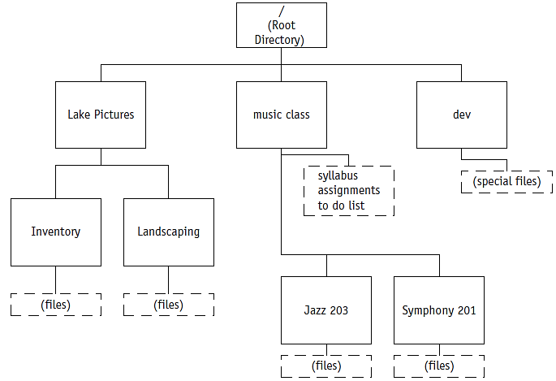
(figure13.9)
File hierarchy seen as an upside-down tree with the forward slash (/ ) as the root, leading next to the directories and subdirectories, and then to the files shown in dashed line boxes.
© Cengage Learning 2014

Slide 11
The Unix File System- inodes
i-nodes
A Unix file is described by an information block called an i-node. There is an i-node on disc for every file on the disc and there is also a copy in kernel memory for every open file. All the information about a file, other than it's name, is stored in the i-node. This information includes
File access and type information, collectively known as the mode.
File ownership information.
Time stamps for last modification, last access and last mode modification.
Link count.
File size in bytes.
Addresses of physical blocks. (I node pointer Structure)

Slide 12
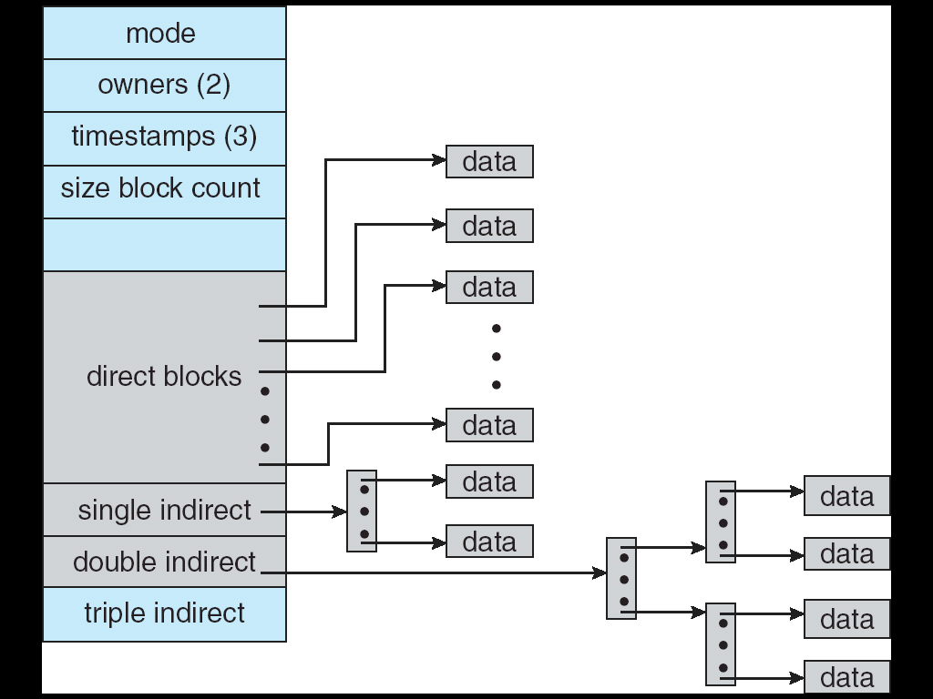
inode technique used by Unix

Slide 13
I-node file address pointer
There are 13 physical block addresses in an i-node
The first ten block addresses refer directly to data blocks,
The next refers to a first level index block (which holds the addresses of further data blocks),
the next refers to a second level index block (which holds the addresses of further index blocks)
the last refers to a third level index block (which holds the addresses of further second level index blocks).
All physical addresses associated with a file are implicitly assumed to reside on the same disc, there is no facility whereby a file could span more than one disc.

Slide 14
When a Unix file is opened
Once a file has been opened the in-memory (the phrase "in-core" is traditionally used) version of the i-node contains significant extra information. This extra information includes
In-core i-node status indicating whether
the i-node is locked
a process is waiting for the i-node to be unlocked
the in-core i-node is dirty, i.e. differs from the disc version
file modifications have been made that haven't been written to disc
The device number of the disc the file belongs to.
The i-node number sometimes known as the i-number. On disc the i-nodes form an array and the i-number is inferred from the i-node's position in this array.
Pointers to other in-core i-nodes.
A reference count indicating the number of instances of the file being active or open.

Slide 15
I node
An inode is a data structure on a traditional Unix-style file system. An inode stores basic information about: a regular file, directory, or other file system object.
A file's inode number can be found using the ls -i command, while the ls -l command will retrieve inode information

Slide 16
Acessing file attributes in linux
The POSIX standard mandates filesystem behavior that is strongly influenced by traditional UNIX filesystems. Regular files are required to have the following attributes:
The length of the file in bytes.
Device ID (this identifies the device containing the file).
The User ID of the file's owner.
The Group ID of the file.
An inode number that identifies the file within the filesystem.
The file mode, which determines what users can read, write, and execute the file.
Timestamps telling when the inode itself was last changed (ctime), the file content last modified (mtime), and last accessed (atime).
A reference count telling how many hard links point to the inode
Compile and Run the Program stat.c to retrieve filesystem related data.

Slide 17
Sample Question: partial Question
What is an i-node (2 marks)
Describe the contents of an i-node (6 marks)
What are three types of additional information contained in an “in-core” i-node (4 marks)
Distinguish between direct block pointers, single direct, double direct and triple direct block pointers in an i-nodes (8 marks)

